Slide 1
PROJECT 2:
DATA WRANGLING & DATA ACQUISITION
-ANIKET PATIL
DIGICROME ACADEMY

Slide 2
To perform data wrangling on a set of datasets. The datasets have many ambiguities. Identify those and apply different data-wrangling techniques to get a dataset for further usage.
PROBLEM STATEMENT:

Slide 3
• Data acquisition
• Different methods for data wrangling:
1.Merge datasets
2. Identify unique values
3. Drop unnecessary columns
4. Check the dimensions of the dataset
5. Check the datatype of the dataset
6. Check datatype summary
7. Treat missing values
8. Validate the correctness of the data
THE FOLLOWING CONCEPTS ARE USED FOR THIS PROJECT :

Slide 4
Uploading the dataset_1 as df1
Checking the shape
Checking the columns
Checking the unique values
Checking the info and statical condition of dataset
After performing above steps conclude that:
1. Shape of data is : 610,10
2. No null values
STEP 1:

Slide 5
Uploading the dataset_2 as df2
Checking the shape
Checking the columns
Checking the unique values
Checking the info and statical condition of dataset
After performing above steps conclude that:
1. Shape of data is : 610,8
2. ‘atemp’ column contains null values
3. Unnecessary ‘Unnamed’ column dropped
STEP 2:

Slide 6
Merging the dataset df1 and df2
Checking the shape
Checking the columns
Checking the unique values
Checking the info and statical condition of dataset
After performing above steps conclude that:
1. Null values replaced by mean values for ‘atemp’ column
2. No null values
3. Categorical data convert into numeric
STEP 3:

Slide 7
Uploading dataset_3 as df3
Checking the shape
Checking the columns
Checking the unique values
Checking the info and statical condition of dataset
After performing above steps conclude that:
1. There is no null values present in df3
2. Categorical data convert into numeric
STEP 4:

Slide 8
Appending at end the merged_df and df3 ad new_df
Checking the shape
Checking the columns
Checking the info and statical condition of dataset
After performing above steps conclude that:
1. There is no null values present in new_df
STEP 5:

Slide 9
instant 0.000000
mnth 0.812772
hr -0.063524
holiday 6.229578
weekday 0.021925
weathersit 1.044098
temp 0.547997
atemp 0.435927
hum 0.436893
windspeed 0.433675
casual 3.414105
registered 1.296723
cnt 1.137709
STEP 6:
CHECKING THE SKEWNESS OF NEW_DF

Slide 10
STEP 7:
GET CORRELATION
By observation,
The column name atemp, registered and cnt highly correlated

Slide 11
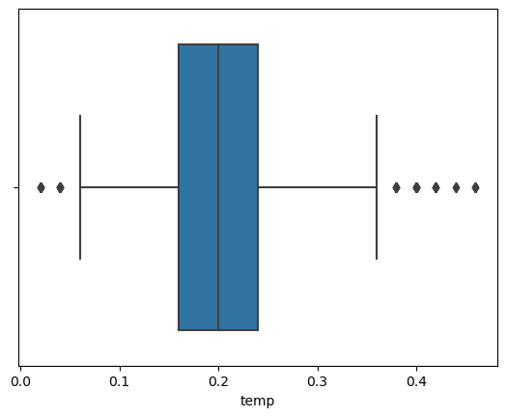

Q1 : 0.16
Q2 : 0.2
Q3 : 0.24
median : 0.2
Upper Tail : 0.36
Lower Tail : 0.04000000000000002
IQR: 0.07999999999999999
STEP 8:
IQR & BOXPLOT (FOR 'temp’ COLUMN)
Boxplot Before imputing the outliers
Boxplot after imputing the outliers

Slide 12

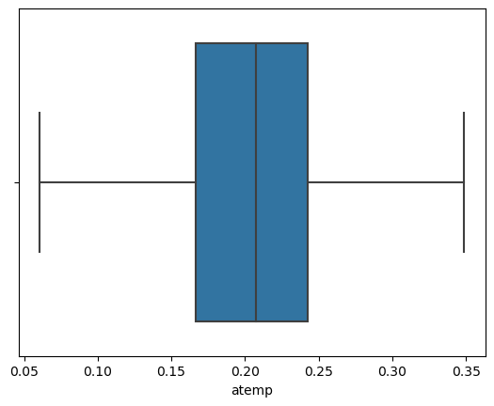
Q1 : 0.1667
Q2 : 0.20745264213383097
Q3 : 0.2424
median : 0.20745264213383097
Upper Tail : 0.35595000000000004
Lower Tail : 0.05314999999999996
IQR: 0.07570000000000002
STEP 9:
IQR & BOXPLOT (FOR ‘atemp’ COLUMN)
Boxplot Before imputing the outliers
Boxplot after imputing the outliers

Slide 13
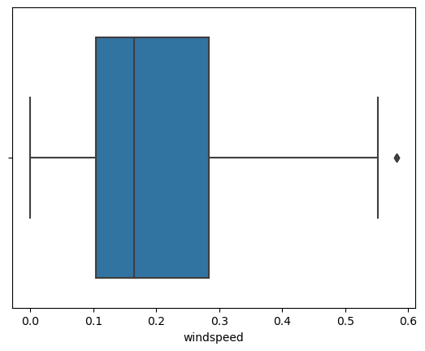
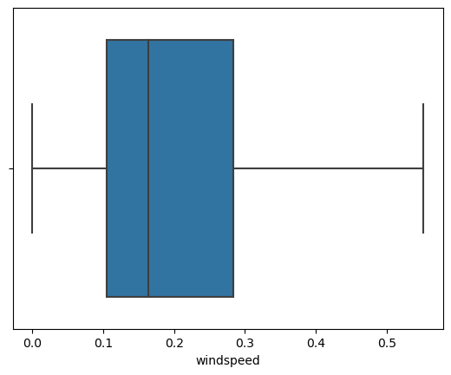
Q1 : 0.1667
Q2 : 0.20745264213383097
Q3 : 0.2424
median : 0.20745264213383097
Upper Tail : 0.35595000000000004
Lower Tail : 0.05314999999999996
IQR: 0.07570000000000002
STEP 10:
IQR & BOXPLOT (FOR ‘windspeed’ COLUMN)
Boxplot Before imputing the outliers
Boxplot after imputing the outliers

Slide 14
RESULTS & ACHIEVEMENTS
From this Project I have learned Data Acquisition and data wrangling techniques. Like Merge datasets, Identify unique values, Drop unnecessary columns, Check the dimensions of the dataset, Check the datatype of the dataset, Check datatype summary, Treat missing values, Validate the correctness of the data. Outlier detection & handling, IQR, Skewness, Correlation.

Slide 15
CONCLUSION
By performing Data acquisition and data wrangling techniques I cleaned the data and achieved desired output. Plotting the outliers and imputing the same by boxplot. As per correlation table most correlated factors are temp, atemp, cnt

Slide 16


